Slide 1
Learning D3
What Is Data Visualization?

Slide 2
Data Visualization Definition
The Presentation of data in graphical / pictorial format. Information that has been abstracted in some schematic form, including attributes for units of information
Data is often better understood through graphical representation.

Slide 3
Visual Perception
Humans can distinguish differences in the following attributes with minimal effort and thought
Length
Shape
Color
These are referred to as “pre-attentive attributes”

Slide 4
Data Visualization Advantages
Easier to read & understand
Absorb data & information in new and more constructive ways
Visualize relationships & patterns
Compare data
Is the data complete?
Trends over time

Slide 5
Effective Characteristics
Organize & present the data in the most efficient way possible
Avoid distortion of data
Make large data sets coherent & understandable
Show data at multiple levels of detail
Integrate with statistics and verbal descriptions of a data set
Make sure the data is complete

Slide 6
Common Examples
Maps
Charts – Bar, Pie, Line, Histograms, Scatterplots
Tables & Lists
Blueprints and Schematics

Slide 7
Bar Chart
Visual Dimensions
Length / Count
Category
Color

Slide 8
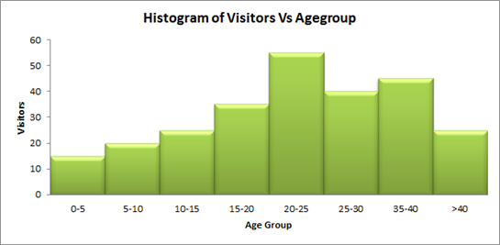
Histogram
Visual Dimensions
Bin Size
Count / Length
Color

Slide 9
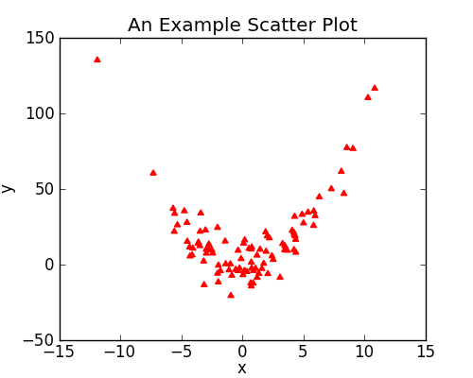
Scatterplot
Visual Dimensions
X & Y Positions
Color
Size

Slide 10
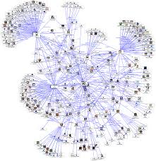
Network
Visual Dimensions
Node Size
Nodes Color
Ties Color
Ties Thickness
Spatialization

Slide 11
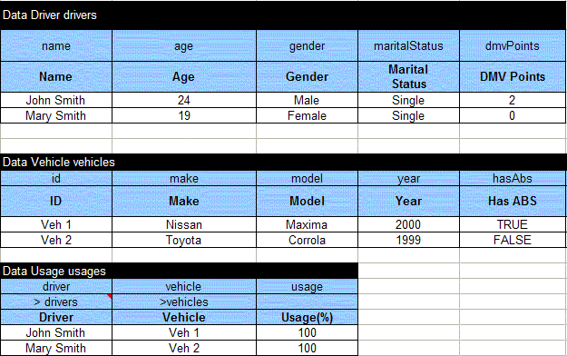
Tables
Visual Dimensions
Columns & Rows

Slide 12


